Slide 1
Analysis of Vibration Frequencies as a method of screening for long bone fractures in children
David Fennimore¹, Ridita Ali², Lyuba Aboul², Amaka C Offiah³
Final Year Medical Student, University of Sheffield
Engineering, Sheffield Hallam University
Department of Oncology & Metabolism, University of Sheffield/Sheffield Children’s NHS Foundation Trust

Slide 2
Extremity Fractures in Children
Radiographs are the gold standard diagnostic tool
Risks of irradiation
21% of wrist radiographs for suspected fractures are negative
Over £100,000 in Sheffield per year
Roughly £12 million per year in England and Wales
Notes:
Wrist fractures are the commonest fracture in children
Radiographs involve exposure to ionising radiation, to which children are especially sensitive
High proportion of radiographs show no fracture, and are therefore unnecessary

Slide 3
Study Aims & Objectives
Can vibration differentiate sprains from fractures?
Can it be used as a screening tool?
Do patients prefer it to radiographs?

Slide 4
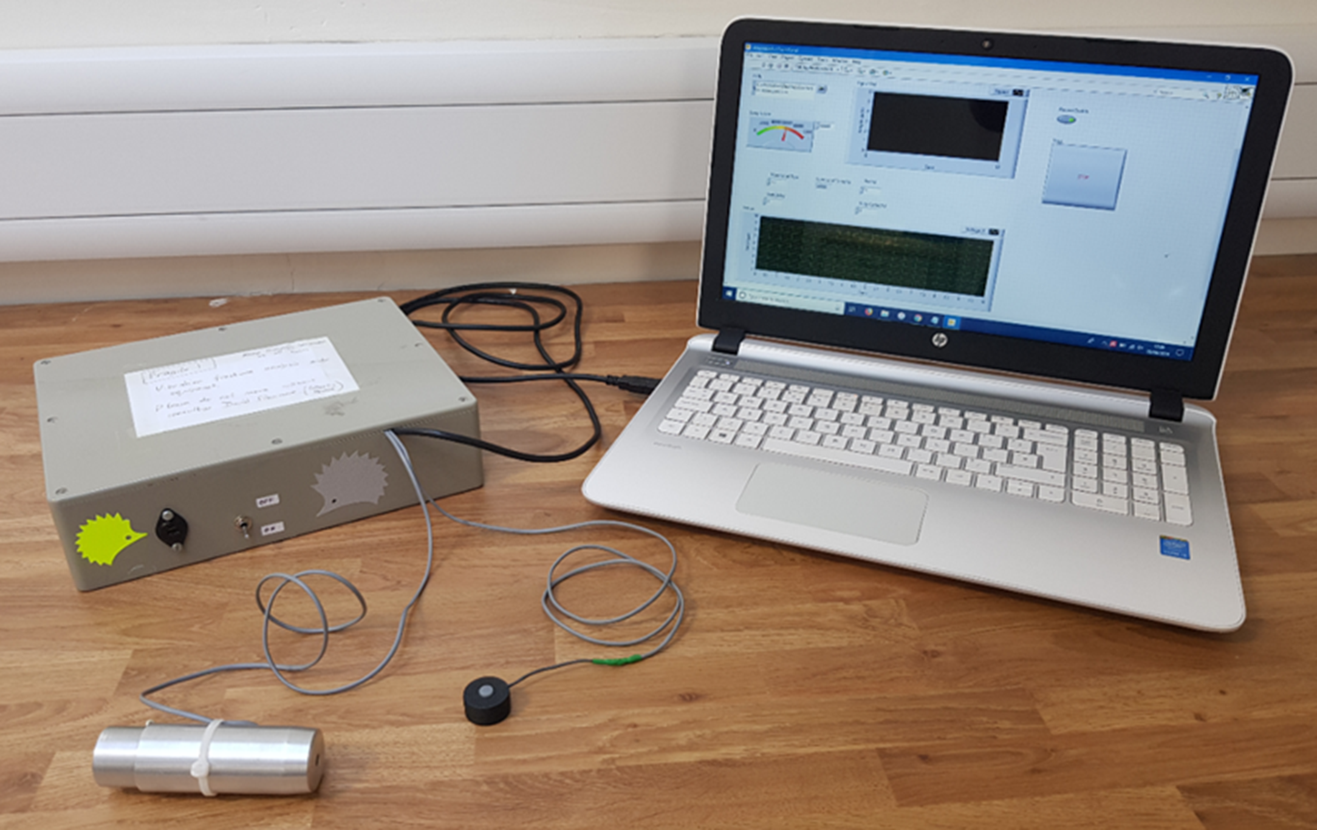
Vibration Technique
Notes:
The device:
Hand held device was developed to induce vibrations to a target and use a piezoelectric sensor to record the corresponding vibration responses.
The silver tube is the vibration inducer, which induces 10 impulses in 10 seconds, the black sensor records the responses.
Inducer is placed on elbow, sensor on wrist.
Hedgehog stickers to make the device appear more child friendly.
Tested on adults first, shown to cause no pain.

Slide 5
Frequency Spectrum
Good quality
Poor quality

Slide 6
Analysis
MATLAB
Filter and Hamming Window
Fast Fourier Transform
Median frequency compared to cut of values (below cut off suggests fracture)
Males 37 V/Hz
Females 26 V/Hz

Slide 7
Methods
Prospectively recruited 100 children from A&E (10-15)
99 unilateral injury to the wrist
Performed vibration analysis
Blinded to outcome of imaging
Interpreted the radiographs (presence/site of fracture)
Blinded to outcome of vibration
Compared vibration results to radiographs
Patient questionnaire
Notes:
One patient excluded for elbow injury
Aged 10-15 inclusive
Consultant radiologist interpreted radiographs
First 50 patients given questionnaire regarding their preference for vibration or radiographs

Slide 8
Results
Imaging Outcome | Vibration Outcome |  | Total
 | Fracture | No Fracture
Fracture | 38 | 2 | 40
No Fracture | 29 | 30 | 59
Total | 67 | 32 | 99
Sensitivity: Specificity: Positive predictive value: Negative predictive value:
38/40 = 95% 30/59 = 51% 38/67 = 57% 30/32 = 94%

Slide 9
Results
Potential action in the 99 patients:
30% true negatives (would have avoided radiography)
51% reduction in sprains having radiographs
67 (67%) proceed to imaging (38 had fractures)
2 (2%) false negative (discharged with missed fracture)

Slide 10
Results

Slide 11
Discussion
Sensitivity 95% (CI – 83-99%)
Ottawa ankle rules sensitivity 97.8%
If used pre-hospital:
Avoid radiation
Avoid A&E
Avoid costs for NHS
Notes:
Confidence interval includes an excellent sensitivity, but also unacceptably low values. High end is comparable to Ottawa ankle rules, which also screen for sprains
Potential benefits if used prior to A&E attendance

Slide 12
Limitations
Sample size of 99 (from a single centre)
Exclusion criteria:
Previous fracture
Bilateral trauma
Notes:
Single centre study did not allow for interrater reliability, which would be necessary because the intended use is by lay people with clear instructions, therefore it is important to understand any impact of different operators on the outcomes
Excluding previous fractures was because of unknown impact of healed fracture on the vibration qualities of a bone. Bilateral trauma was because we scanned both arms for comparison, which would not be necessary in future studies

Slide 13
Improvements
High pass filter
Adaptive Kalman Filter
Signal-to-noise ratio
Notes:
High pass filter – to reduce background noise
Kalman filter – further reduce background noise
Signal-to-noise ratio gives quantitative measure of scan quality, which could be used to eliminate the human aspect of analysing the quality of the scan

Slide 14
Conclusions
Supports the hypothesis that vibration analysis can be used as an effective screening tool
Further study required to maximise potential
Further applications
Notes:
Further applications include adult wrists, younger children and other common fracture sites

Slide 15
Acknowledgements
Professor Amaka C Offiah
Dr Ridita Ali
Dr Lyuba Alboul
The University of Sheffield
Department of Oncology & Metabolism
Sheffield Hallam University

Slide 16
Thank you for listening Any questions? Please type them in the Q&A function and they will be answered at the end of this morning’s session

